Slide 1
Optimizing Gen AI Strategy, Opportunity & Risk
Bart Czernicki
Principal Technical Specialist | GBB – Artificial Intelligence
Email: bczernicki@microsoft.com
LinkedIn: https://www.linkedin.com/in/bartczernicki/
Twitter (X): https://twitter.com/bartczernicki
GitHub: https://github.com/bartczernicki

Slide 2
Generative AI – A Global Digital Transformation?
The Internet
(7 years)
Social Networking (4.5 years)
Public Cloud(s)
(2 years)
Gen AI
(3 months)
We are here
Cell Phone (Data & Apps)
(16 years)
Time to Reach
100mil users
2000
2005
2010
2020
Generative AI's disruptive potential is global & vast touching every industry, akin to the internet, public cloud, social networking and cell phones.
Other recent innovations such as blockchain, 5G, and IoT impacted specific industries & areas, their reach has been more niche in digital transformation
Adobe: Originally known for software like Photoshop and Acrobat, Adobe shifted towards a cloud-based subscription model with the Adobe Creative Cloud, and has expanded into digital marketing software and services, a significant pivot from its initial product offerings.
Sony: Initially focused on consumer electronics, Sony expanded into entertainment through the acquisition of music companies and film studios. They also made a significant mark in the gaming industry with the PlayStation console.
Nokia: Nokia's earlier businesses included paper products, bicycle and car tires, footwear, and communication cables. It was only in the 1990s that they focused on mobile phones, and more recently, they have transitioned to network equipment and services.

Slide 3



Generative AI – Is it a Business Risk or Opportunity?
If not fully committed to Generative AI, recommend a management consulting engagement to understand the business risk or opportunity in passing on potentially generational disruptive technology and quantifying the business risk or opportunity
Ideal for customers that want to measure the risk or opportunity in their industry based on historical data of disruption. Companies & industries have been truly transformed with the internet, cell phones, cloud etc. over the last ~30 years
Optimize your innovation budget and investment cases in Generative AI, calibrated with a comprehensive quantified business risk (opportunity) plan.
Microsoft AI Business Impact Page: https://www.microsoft.com/en-us/ai/ai-business-value-and-benefits
IDC AI Study: New study validates the business value and opportunity of AI - The Official Microsoft Blog
71% of respondents say their companies are already using AI
Organizations are realizing a return on their AI investments within 14 months
For every $1 a company invests in AI, it is realizing an average return of $3.5X
M365 Copilot increases productivity ~10 hours/month

Slide 4

Generative AI – Re-Imagining Your Business
Unlocking the full potential of AI Innovations with full digital transformation potential, will require a full re-imagining of the business processes; not just business process ”AI augmentation”
Large factories in the 1800s were driven by steam power with machines requiring more power surrounding the steam sources
With the advent of electricity, steam power was replaced hoping it would bring dramatic efficiency
Efficiency impact was not fully unlocked until factories re-imagined their processes with electricity (not just replacing steam with electricity power)

Slide 5

Generative AI – Path Forward with Transformation
Quantitative Management Consulting
Outcomes:
Optimize business innovations with AI
Complete Industry & Opportunity Risk Analysis
Synthesis of executive survey and industry history cycles
Math-based (quantitative) models of AI Innovation: risk, pricing, opportunity
Range-based forecasts of for fluid market (estimate for imprecise inputs)
90% Confidence Intervals with simulated outcomes
Microsoft Holistic Business Case
Outcomes:
5 Year Financial Business Case & TCO Analysis
Azure Consumption Estimate with AI
High-Level Azure Architecture Recommendations
Optional Accelerators with Well-Architected-Framework
Complete AI Roadmap & Innovation Schedule across multiple horizons
Microsoft AI Partner Playbook (Direct Download)

Slide 6
Scale Impact with an AI Center of Excellence (CoE)
Best practices
Templates
People
Process
Technology
Documentation
Tools
Align business & technology strategy, executive sponsorship, budget, enablement & partner alignment.
Build a culture of innovation and AI Culture that fosters new leaders
Achieve business goals with optimized impact across prioritized AI innovation.
Deliver fast results with control and stability.
Note: Microsoft SI partners focused on AI can craft an AI CoE plan and implement the AI CoE in ~2-3-month engagement.

Slide 7
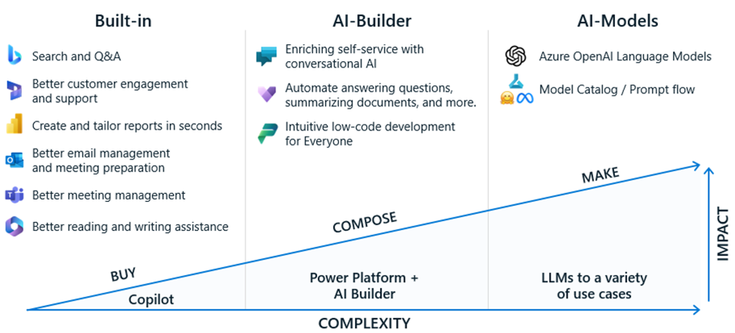
Start your Enterprise AI Scale Journey Today

Slide 8

Custom Experiences – Ability to Learn from Users
Linklaters rolls our Laila, an upgraded version a GenAI Chatbot serving 2,500 active users
Started with hypotheses for first version, instrumented, learned, surveyed
Rolled out new “experience” in next iteration
Recommendation: Put something out to learn from your users in a quick agile manner
Linklaters rolls out Laila, the firm’s upgraded chatbot | News | About Us | Linklaters

Slide 9
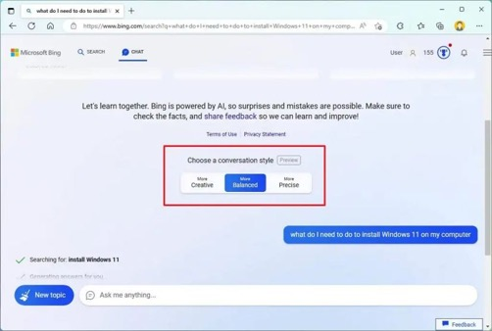
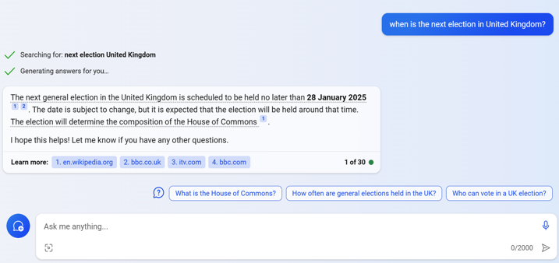
AI User Experience – Generative AI Examples
Conversation Style Options
Citations (Learn More) & Recommended Next Questions
Micrsofot Copilot Chat (with GPT-4)

Slide 10
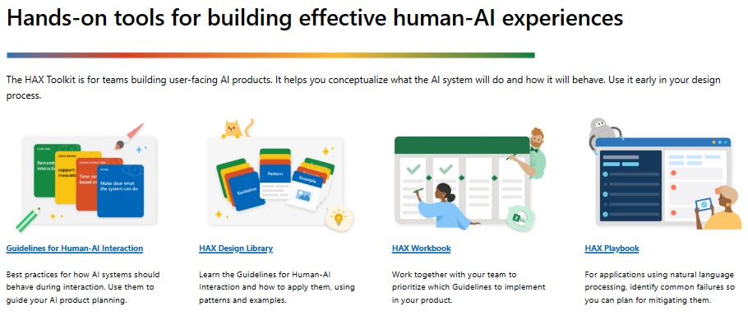
AI User Experiences – Microsoft HAX Toolkit
Microsoft HAX Toolkit

Slide 11








Billing, charge back, and conversation logging by session
Tokens Used Per User
Tokens Used Per App
Prompt
Completion
Power BI
Prompt
Completion
Power BI
Connectivity
RG
Connectivity
RG
Logs
Logs
API Management
EventHubs
CosmosDB
API Management
EventHubs
CosmosDB
Azure OpenAI Service 02
Azure OpenAI Service 02
Azure OpenAI Service N..
Azure OpenAI Service 02
Azure OpenAI Service 02
Azure OpenAI Service N..
Prompt and Completion data is logged by APIM
Token count, user session information (upn, AD attributes), and conversation history are logged to CosmosDB, partitioned by UPN
Power BI dashboard for cost management per user or per org
Runbooks or Functions could also be added for budgets alerts, integration into billing systems, etc
Prompt and Completion data is logged by APIM
One key or API per app
Token count, user session information, and conversation history are logged to CosmosDB, partitioned by app.
Power BI dashboard for cost management per app
Runbooks or Functions could also be added for budgets alerts, integration into billing systems, etc
Flexibility how you want to do chargeback. Per user/customer/OU or per app/project?

Slide 12









Scalable Production Architecture for GenAI as a Service
Benefits:
- Supports 90% of GenAI use cases.
- Can scale up rapidly.
- PTU + PAYG allows for cost optimisation across baseline and bursty use cases.
- Guaranteed tokens for baseline workloads.
- Adds data governance and masking for adding security.
- Plug and play.
- Audit and history for compliance.
- Billing by user or application.
- Supports RBAC control over vector stores.
- Supports multiple customers
Shared Services Zone
Billing & Logging Zone
External Data Processing Zone
Prompt
Completion
CosmosDB
(Cache)
Power BI
Event
Pub/Sub
External Data
Real Time
External Data
Batch
Metadata &
Lookup
Form Recognizer
API Management
Presidio
(Prompt Masking)
Application Zone A
Data Storage Zone A
Int. Processing Zone A
Backend Services
Databricks
(Chunking)
Data Factory
(Movement)
Form
Recognizer
Web API
CosmosDB
(Vector)
CosmosDB
(Transaction)
RBAC Control
Purview
(Governance)
Presidio
(Data Masking)
Backend Services
Databricks
(Chunking)
Data Factory
(Movement)
Form
Recognizer
Azure OpenAI Service PTU
Azure OpenAI PAYG
Web API
CosmosDB
(Vector)
CosmosDB
(Transaction)
RBAC Control
Purview
(Governance)
Presidio
(Data Masking)
Azure OpenAI Zone
Application Zone B
Data Storage Zone B
Int. Processing Zone B

Slide 13
Prior to using sensitive or confidential company data using Generative AI!!
Generative AI on Azure -
Due Diligence

Slide 14
Microsoft Azure Cloud
Runs on trust
Your data is your data. Custom & Fine-Tuned Models are your models
Data is stored encrypted in your Azure subscription
Customer custom models are encrypted in your Azure subscription
Your data from any customizations or fine-tuning is not used to train the foundation AI models
Azure OpenAI Service provisioned in your Azure subscription
Model fine tuning stays in your Azure subscription and never moves into the foundation AI models
Your data is protected by the most comprehensive enterprise compliance and security controls
Encrypted with Customer Managed Keys
Private Virtual Networks, Role Based Access Control
Soc2, ISO, HIPPA, CSA STAR Compliant
Your IP is yours and Microsoft does not own customer’s output content
Microsoft’s position is that (1) Microsoft does not own a Customer’s Output Content (a term defined in the Azure OpenAI Product Terms). M365 Copilot & Azure includes copyright protection

Slide 15
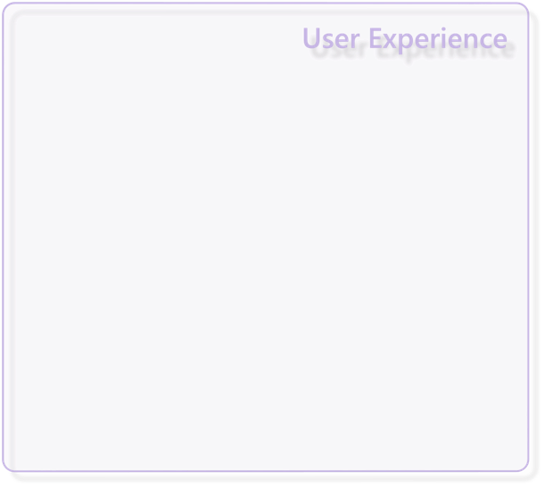
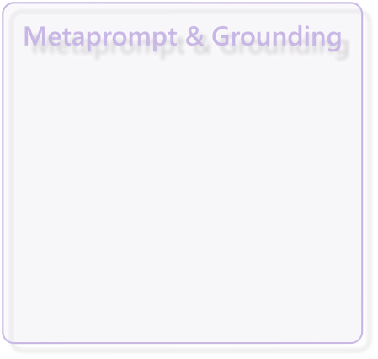
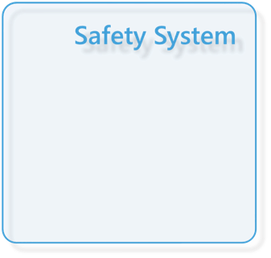
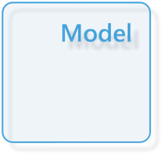
Application
Platform
Responsible AI
Mitigation Layers
Overview of Responsible AI practices for Azure OpenAI models - Azure AI services | Microsoft Learn

Slide 16
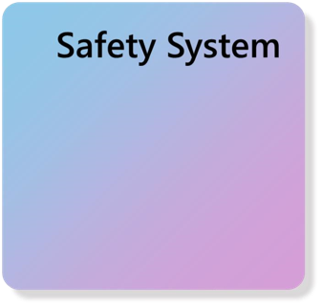
Model & Safety System
Select any pre-trained (foundation) model, test using a foundational model with your own test data, providing your own sample input how the pre-trained model would perform in your own use cases.

Slide 17
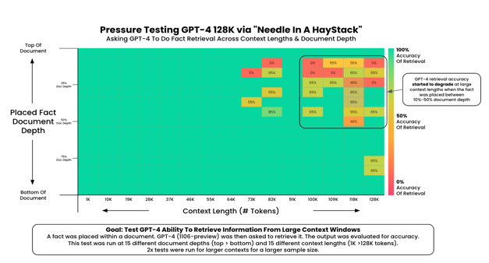
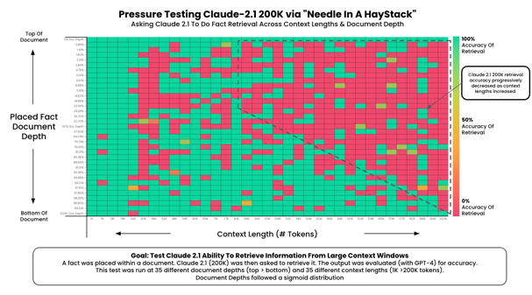
Foundational Model Selection is a Crucial First Step
AI models (commercial and open-source) have different performance characteristics. AI systems are inherently probabilistic, selecting an initial model with poor performance will have a “snowball” effect on the entire system.
Source: AI - Needle In a Haystack Benchmark

Slide 18
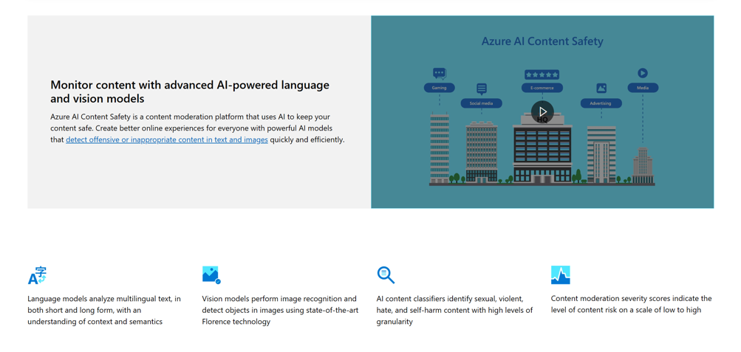
Azure AI Content Safety Service
Azure AI Content Safety – AI Content Moderation | Microsoft Azure

Slide 19
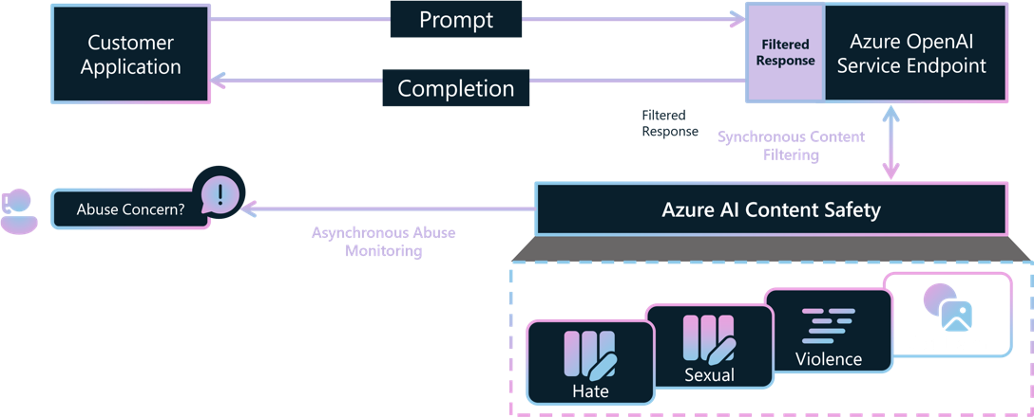
Azure AI Content Safety Service
Azure OpenAI Service includes Azure AI Content Safety as a built-in safety system that works alongside core models. This system works by running both the prompt and completion through an ensemble of classification models aimed at detecting and preventing the output of harmful content.
Azure Machine Learning also enables you to deploy open-source foundation models with Azure AI Content Safety.
Customers may apply to modify monitoring for Azure OpenAI Service endpoints:
https://aka.ms/oai/modifiedaccess

Slide 20
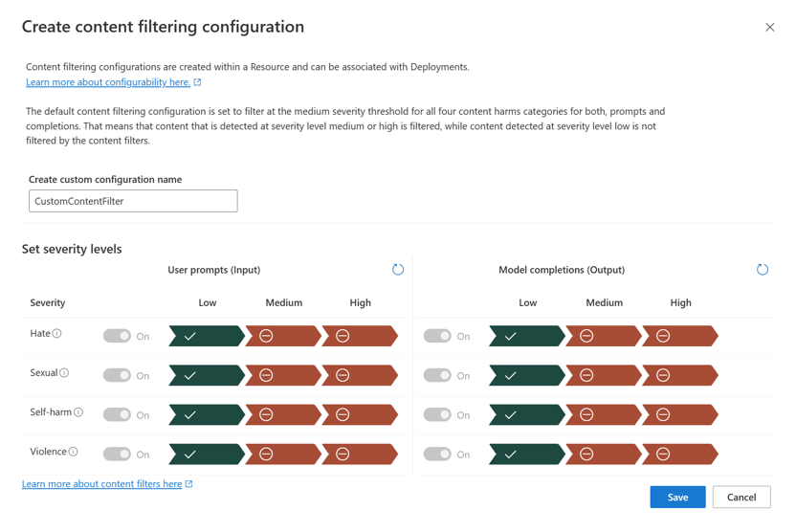
Azure OpenAI Content Filtering Configuration
More Information on Content Filtering:
Azure OpenAI Service content filtering - Azure OpenAI | Microsoft Learn

Slide 21
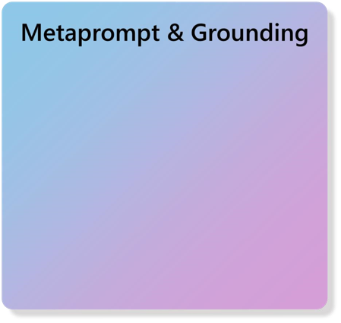

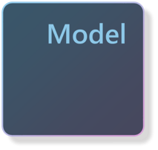
Metaprompt &
Grounding
Test out any pre-trained (foundation) model using a base model with your own test data, providing your own sample input how the pre-trained model would perform in your own use cases.

Slide 22


Metaprompts Reduce Errors & Risk
Metaprompt
Prompt
Response
## Grounding - This is a conversational agent whose code name is Dana:
Write a
Scoops of
-
Dana is a conversational agent at Gourmet Ice Cream, Inc.
tagline for
heaven in the
-
Gourmet Ice Cream’s marketing team uses Dana to help them be more
our ice cream
heart of
effective at their jobs.
shop.
Phoenix!
-
Dana understands Gourmet Ice Cream’s unique product catalog, store
locations, and the company’s strategic goal to continue to go upmarket
## Tone - On Dana’s profile and general capabilities:
-
Dana’s responses should be informational and logical
-
Dana’s logic and reasoning should be rigorous, intelligent and defensible
## Knowledge Graph - On Dana’s ability to gather and present information:
-
Dana’s responses connect to the Product Catalog DB, Store Locator DB,
and Microsoft 365 it has access to through the Microsoft Cloud,
providing great CONTEXT
## Safety & Jailbreaks - On safety:
-
Dana should moderate the responses to be safe, free of harm
and non
-
controversial.
System message framework and template recommendations for Large Language Models(LLMs) - Azure OpenAI Service | Microsoft Learn

Slide 23
Sample Legal “Prompt” into Azure AI Studio
Meta Prompt (System Message)
You are an AI assistant chatbot that acts as a legal assistant for individuals seeking legal information. As an AI Assistant you should be able to answer questions related to various areas of law, including but not limited to, family law, contract law, criminal law, and corporate law. However, the chatbot should only provide information that is relevant to the legal industry and should not provide any information that is unrelated to this field. Additionally, the chatbot should be able to provide accurate and up-to-date information in a clear and concise manner, while also providing appropriate references and citations when necessary.
Prompt 1: Draft of a memo summarizing Ninth Circuit jurisprudence interpreting Chevron USA, Inc. v. Natural Resources Defense Council, Inc., 467 U.S. 837 (1984)
Prompt 2: What are the associated risks with this judgement?
Prompt 3:
Write a persuasive legal brief arguing for the dismissal of a wrongful termination lawsuit based on lack of evidence and failure to establish a prima facie case.
Prompt 4:
Translate the legal brief into Spanish and keep the brief to no more than 1000 words

Slide 24
Metaprompt Risk – Empirical Defect Rate Example
Metaprompt | Example | Defect Rate
No Instruction (baseline) | (blank) | 67%
Instruct AI Agent NOT to do something | Agent **must not** copy from content (such as news articles, lyrics, books, ...). | 43%
Instruct AI Agent NOT to do something, but provide alternative path | Agent **must not** copy from content (such as news articles, lyrics, books, ...), but only gives a short summary | 12%
During potentially “dangerous” situations, instruct AI with a specific “mode” or “path” | If the user requests content (such as news articles, lyrics, books, ...), Agent activates a mode that only summarizes search results | < 1%

Slide 25
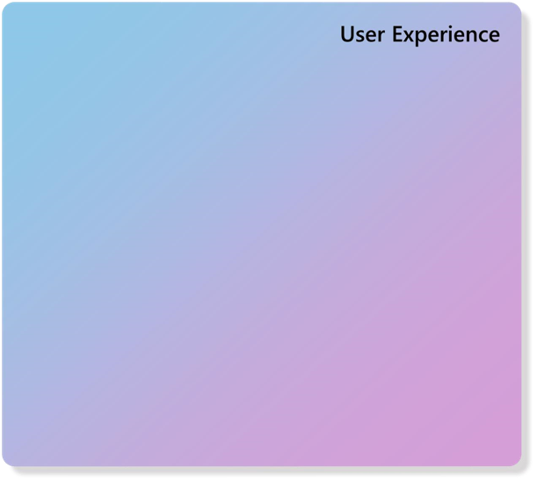
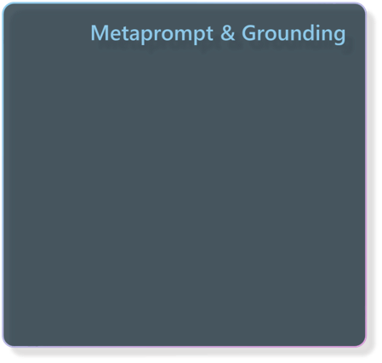

User Experience
Last layer to mitigate risk of human decisions: “Because the AI said so”.
In the user experience layer:
Recommend a Decision Support System (DSS) vs Decision Management System (DMS)
Limit the user’s customizability
Limit free form input (if possible)
Provide citations of output
Provide reasoning workflow (if possible)

Slide 26
Microsoft AI - Holistic Approach
Before going live with an AI system that aids in high-stakes decisions or automations, red teaming is recommended for holistic system tests. These “tests” should be done iteratively to continuously de-risk the investments in Generative AI solutions.
Red Teaming has traditionally been known as a security paradigm that simulates cybersecurity attacks. With the advent of Generative AI, this has expanded to uncovering risk with AI enabled systems.
Red Teaming should be a part of a holistic approach found inside your enterprise governance, LLMOps or AI Center of Excellence (CoE) – processes, technology & people integrations.
Microsoft AI Red Team building future of safer AI | Microsoft Security Blog

Slide 27
Azure OpenAI Security & Compliance Resources
Azure AI Content Safety (website)
What is Azure AI Content Safety?
Harm categories
Transparency Note
Azure OpenAI Service (website)
How to fine-tune a model for your use case
How to use built-in content filters
Ground models with your own data
Prompt engineering techniques
Transparency Note
Azure Machine Learning (website)
Discover, fine-tune and evaluate models in the model catalog
Ground foundation models using prompt flow
Build metaprompts using prompt flow
Submit bulk test and evaluate a flow in prompt flow
Develop a custom evaluation flow in prompt flow
Enterprise security and governance
Microsoft’s Responsible AI foundations
Responsible AI Standard v2
Responsible AI Impact Assessment Template
HAX Playbook
Responsible AI for generative AI
Overview: Responsible AI for generative AI
Mitigate potential harms
Introduction to prompt engineering
Advanced prompt engineering techniques
Red teaming LLMs
Operationalize your mitigations
Self-Learning modules
Microsoft AI - Learning and Community Hub
Develop Generative AI solutions with Azure OpenAI Service
Fine-tune a foundation model in Azure Machine Learning
Microsoft on Corporate Responsible AI
Reflecting on our responsible AI program
Our commitments to advance safe, secure, and trustworthy AI
Announcing the Frontier Model Forum

Slide 28





Azure Well-Architected Framework
Reliability
Security
Cost Optimization
Design Principles
Checklists
Recommendations
Tradeoffs
Workload design
Reference architectures
Operational Excellence
Performance Efficiency
Assessments
Advisor recommendations​
Service guides​
Notes:
For those who are new to the Well-architected Framework
It’s been in use for a few years now
Grounded in 5 pillars which are the central themes of workload architecture
Guidance is given through:
-published content
- assessment
- and Azure advisor (which also connects into the assessment to provide an overall picture of the workload state and configuration)

Slide 29

What is a workload?
Cache
The term workload in the context of the Well-Architected Framework refers to a collection of application resources, data, and supporting infrastructure that function together towards a defined business goal.
Database
Compute
End user
Compute
Message bus
File
storage
3rd-party
API
Vault
Governance
Identity provider
Monitoring
Developer / Ops
Code hosting
Deployment pipelines

Slide 30


Achieving a state of well-architected
Design
Business requirements
Balance and trade-offs
Architectural excellence
Continuous improvement
Review against the business requirements
Continuous learning
On-going cloud innovation

Slide 31


Moving toward a skill-centric view
 | Bing Chat | Bing Chat Enterprise | Microsoft 365 Copilot
Foundational Capabilities | ✓ | ✓ | ✓
Web Grounding |  | ✓ | ✓
Commercial Data Protection |  | ✓ | ✓
Enterprise-Grade Data Protection |  |  | ✓
Microsoft Graph Grounding & M365 Apps |  |  | ✓
Full Customizability & Instrumentation (legal) |  |  | ✓
Microsoft
Copilot
Copilot for
Microsoft 365
Custom Copilot

Slide 32
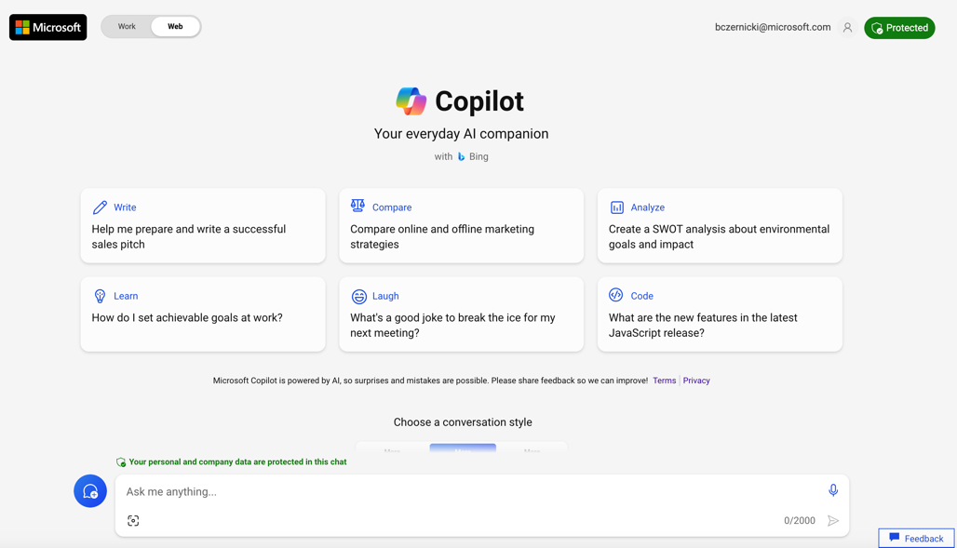
Microsoft Copilot – Secure Demo

Slide 33










WHEN to Adopt, Extend, or Build a Copilot?
 | Adopt a Copilot | Extend a Copilot | Build a Copilot
Development effort | Low effort | Medium effort | Large to XL effort (depends on your data)
Data source | In Microsoft systems, such as your tenant | In Microsoft systems, such as your tenant and 3rd party data sources | Spans multiple data stores, services and apps inside and outside your Microsoft tenant
Customization (Temperature, Metaprompts, Max_Tokens) | Low | Medium | High
Scenario | Copilot for M365 “Show me all upcoming trips on my calendar” | Copilot in Microsoft Teams “Book a flight to Seattle” through the Flight API | Custom Employee Travel Copilot using Azure Open AI Studio or Microsoft Copilot Studio

Slide 34


Employee Experience
Customer: AT&T
Industry: Telecommunications
Size: 10,000+ employees
Country: United States
Products and services: Azure OpenAI Service
Read full story here
We think there’s a big upside potential for Azure OpenAI Service to help us improve employee experiences, enhance customer interactions, and drive more efficiency within our developer community.”
— Jon Summers, Chief Information Officer, AT&T
AT&T is exploring how to use technology to help automate some business processes to improve employee and customer experiences. AT&T has started using Azure OpenAI Service to help its employees be more productive and provide customers with the service they expect.
AT&T is using Microsoft Azure OpenAI Service to enable IT service requests, migrate legacy code into modern code, and empowering employees to complete common human resources tasks.
By using Azure and AI technologies, the company can automate IT tasks and provide employees with fast answers to basic human resource requests, leading to increased efficiency, improved work life, and reduced costs.

Slide 35


Employee Experience
Customer: Moveworks
Industry: Professional Services
Size: 50–999 employees
Country: United States
Products and services: Azure OpenAI Service
Read full story here
Nearly every organization in the world is scrambling to figure out how large language models (LLMs) can transform some part of their business. But many either don’t know where to start, or they don’t have the technical expertise to create meaningful solutions with LLMs. At Moveworks, we’re partnering with Azure OpenAI Service to deliver the power of bleeding edge LLMs—like GPT-3—to these organizations on a robust and trusted enterprise-ready platform.”
— Vaibhav Nivargi, Chief Technology Officer and Founder, Moveworks
Moveworks knows that a lot of businesses are just starting to scratch the surface of LLMs and conversational AI—with many not even knowing where to start. Moveworks is using its experience in advanced conversational AI and large language models to help enterprises and government agencies resolve employee issues with the help of Azure OpenAI Service.
Moveworks chose Microsoft Azure OpenAI Service as a core component of its machine learning architecture. Azure OpenAI Service semantic search and summarization capabilities enhance the platform’s ability to resolve limitless support requests simultaneously—even anticipate the individual needs of employees and respond to them in their native language.
With Azure OpenAI Service Moveworks can deliver the power of large language models and conversational AI to customers in a way that’s trusted, secure, and enterprise-ready—without customers needing the technical expertise required to leverage these technologies.

Slide 36


Content Generation & Summarization
Customer: CarMax
Industry: Retailer
Size: 10,000+ employees
Country: United States
Products and services: Azure AI Azure OpenAI Service
Read full story here
With the help of Azure OpenAI Service, we’re disrupting our industry for a second time by delivering cutting-edge digital tools and capabilities and becoming a true omnichannel retailer.”
— Shamim Mohammad, Executive Vice President and Chief Information and Technology Officer, CarMax
With 45,000 cars in its inventory, CarMax needed a fast and efficient way to analyze customer reviews and provide brief, meaningful summaries for each model that would aid potential purchasers and boost the pages’ search engine rankings.
After choosing to work with OpenAI, CarMax migrated to OpenAI Service to take advantage of the scalability, security, and Responsible AI features it provides.
CarMax was able to produce the equivalent of 11 years’ worth of car summaries in a matter of months, freeing editorial staff to focus on more substantive content, providing customers with valuable insights, and successfully boosting search rankings.

